Slide 1
Notation Summary

Slide 2
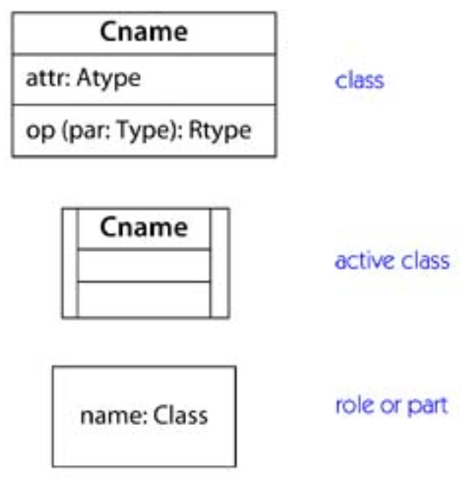
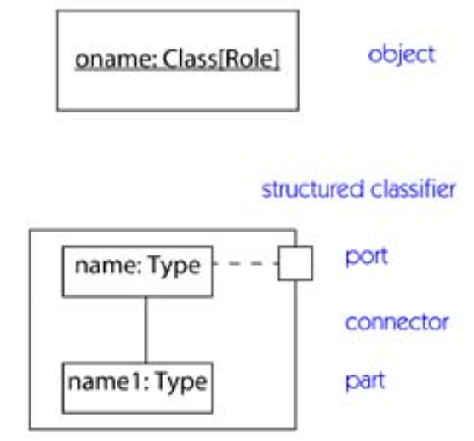
Icons on class, component, deployment, and collaboration diagrams

Slide 3
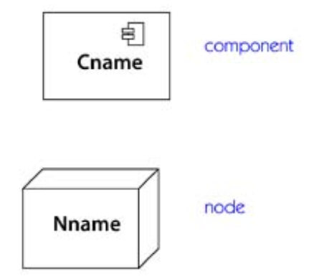
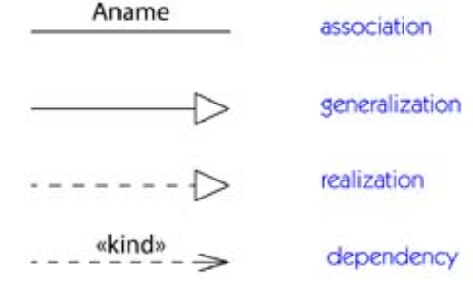
Icons on class, component, deployment, and collaboration diagrams

Slide 4
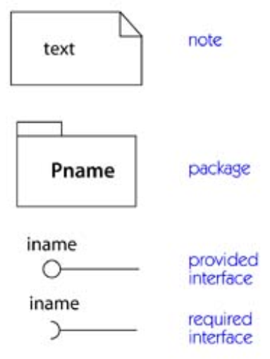
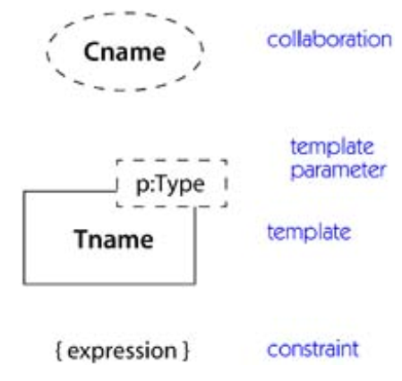
Icons on class, component, deployment, and collaboration diagrams

Slide 5
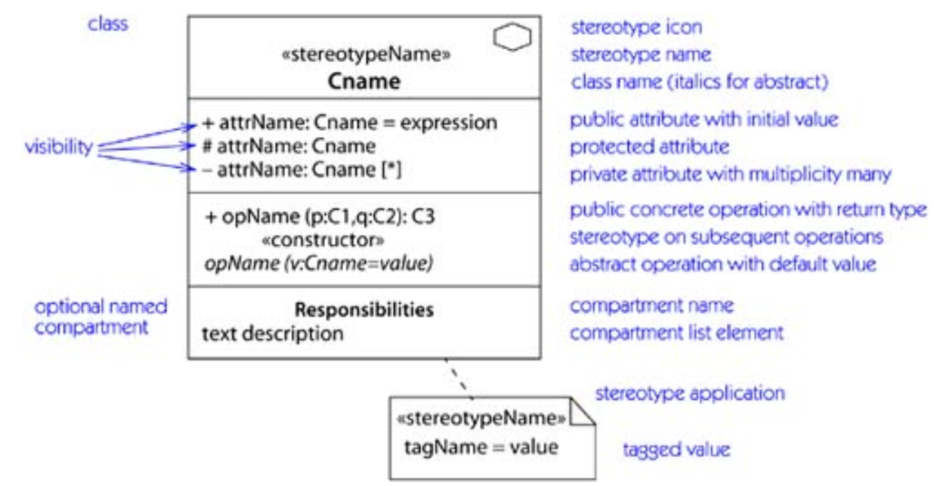
Class contents

Slide 6
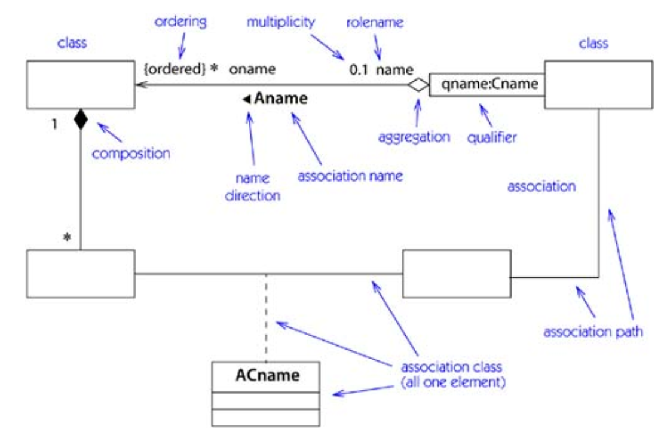
Association adornments within a class diagram

Slide 7
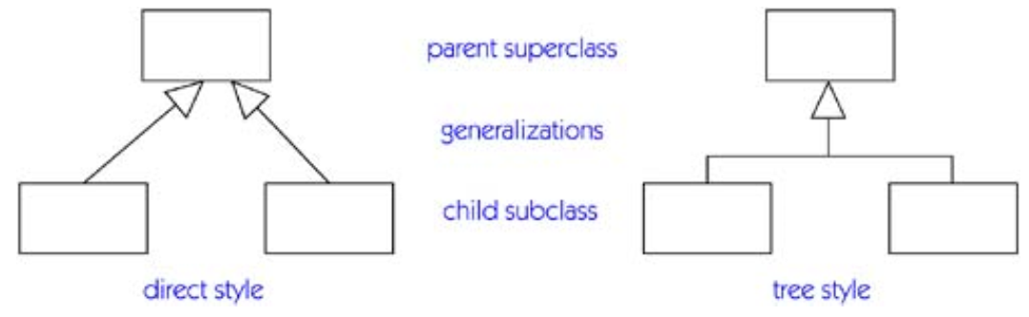
Generalization

Slide 8
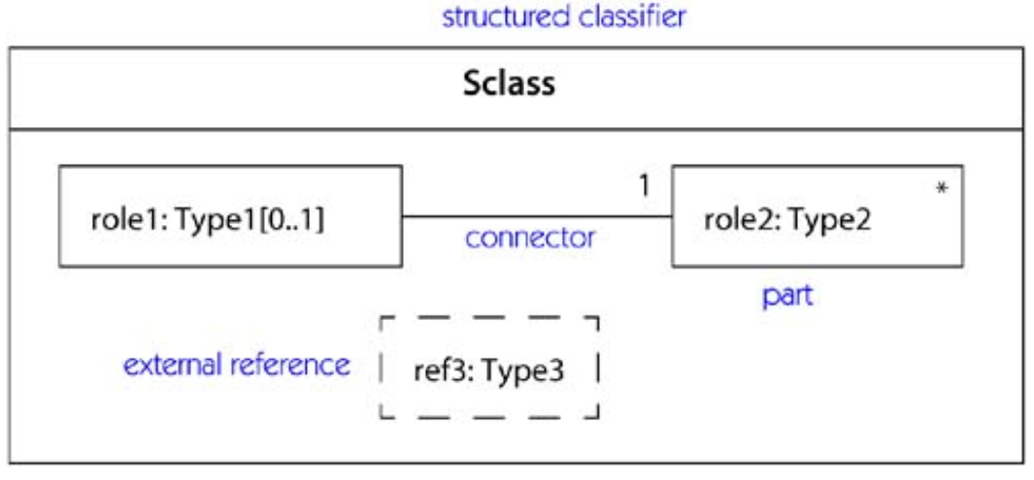
Internal structure: parts and connectors

Slide 9
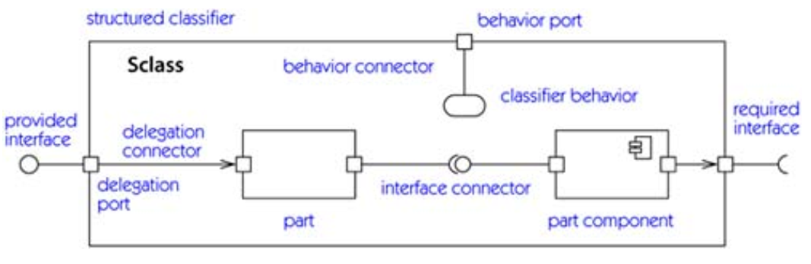
Internal structure: interfaces, ports, and internal wiring

Slide 10
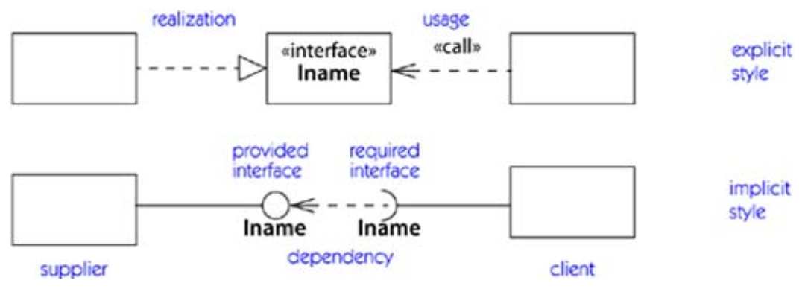
Realization of an interface

Slide 11
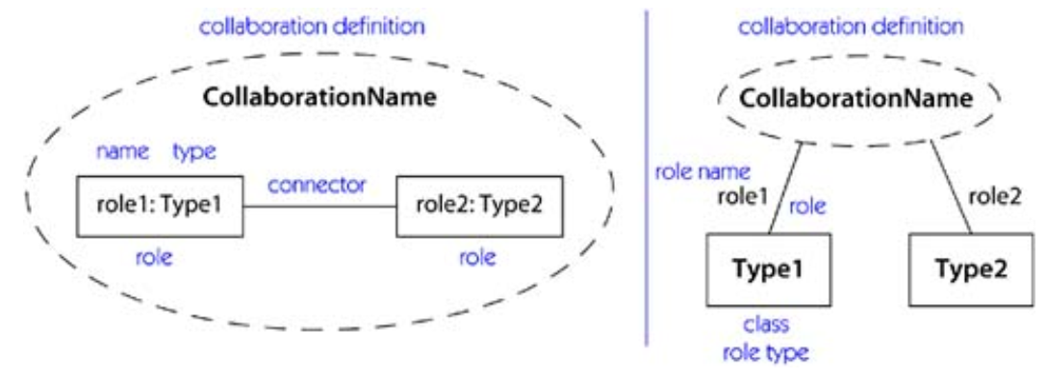
Collaboration definition—alternate notations

Slide 12
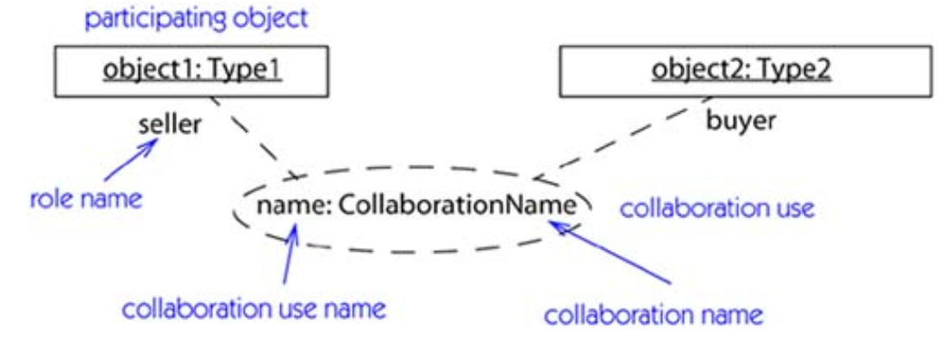
Collaboration use

Slide 13
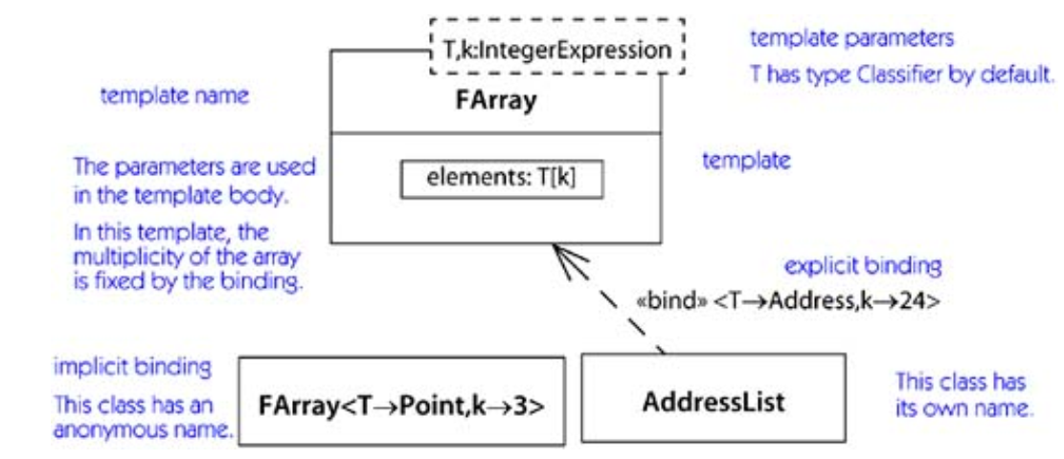
Template

Slide 14
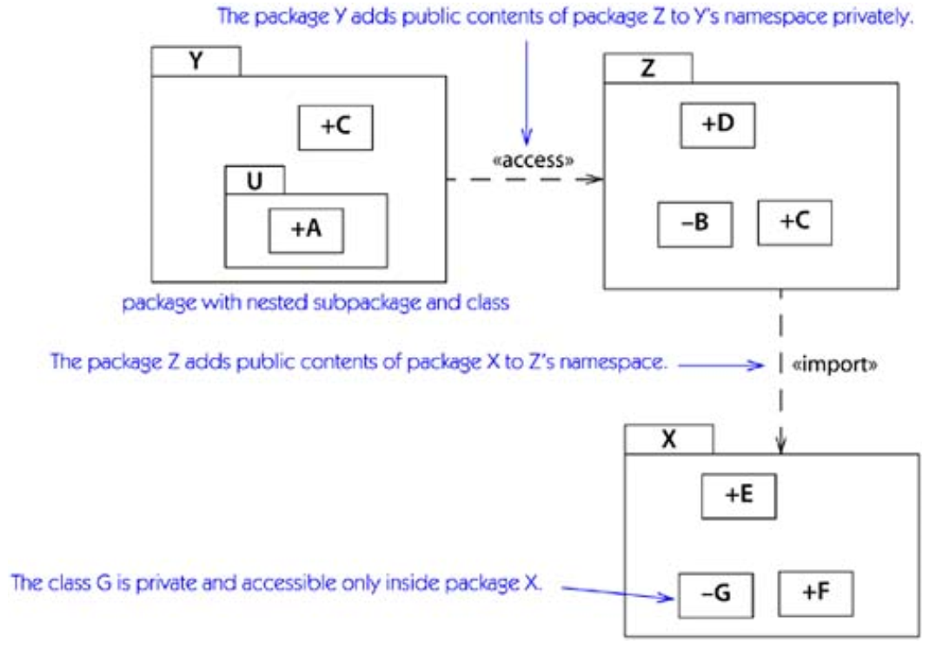
Package notation

Slide 15
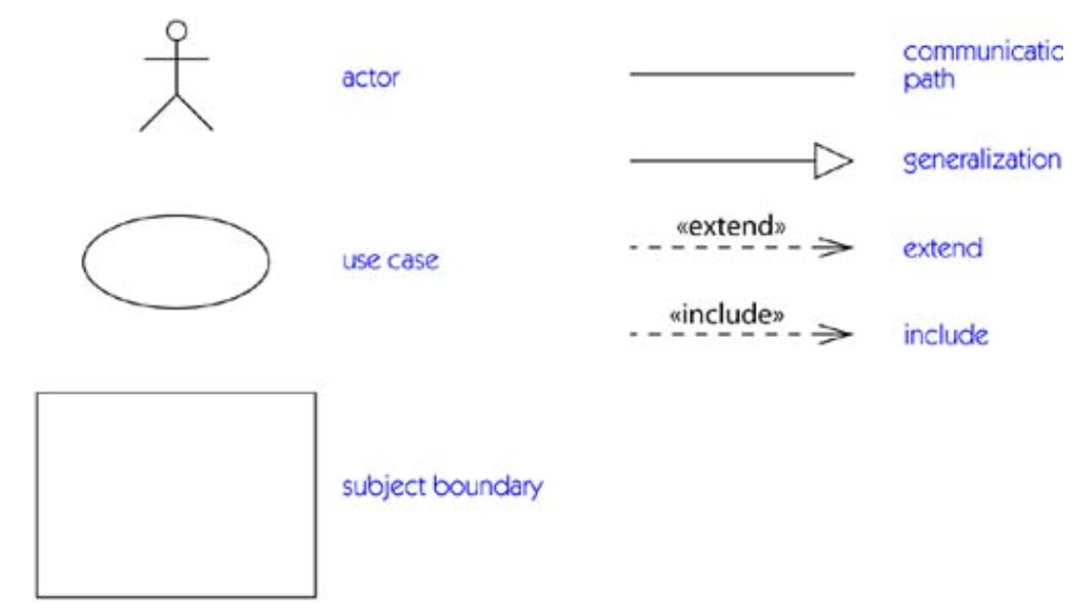
Icons on use case diagrams

Slide 16
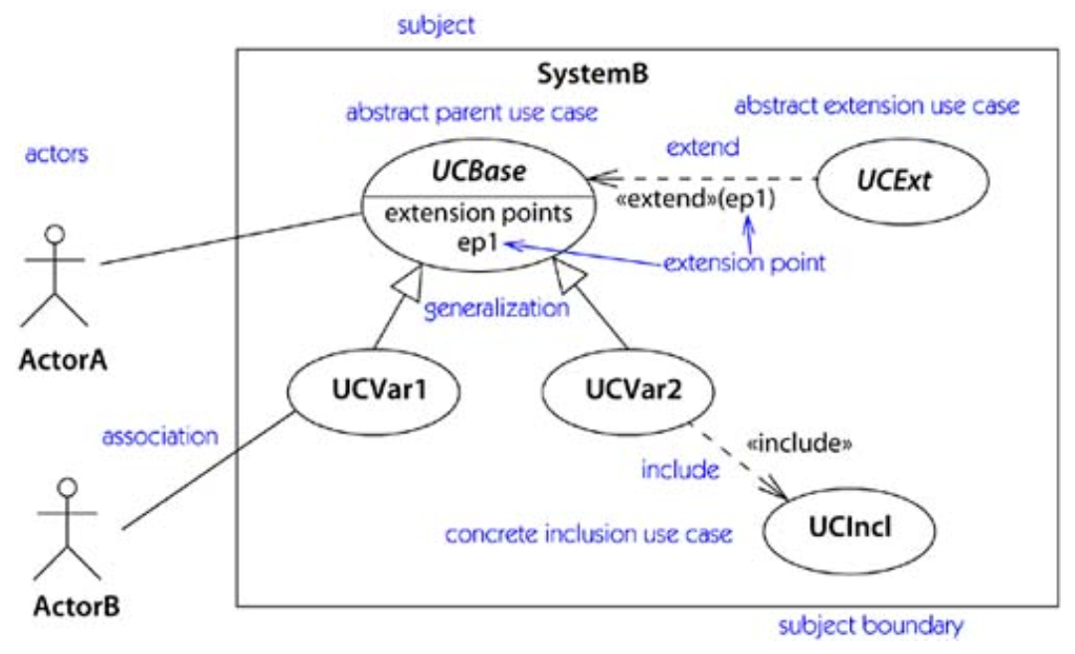
Use case diagram notation

Slide 17
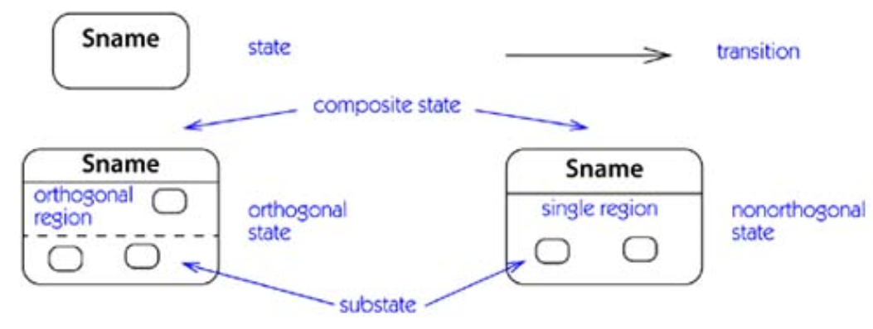
Icons on state machine diagrams

Slide 18
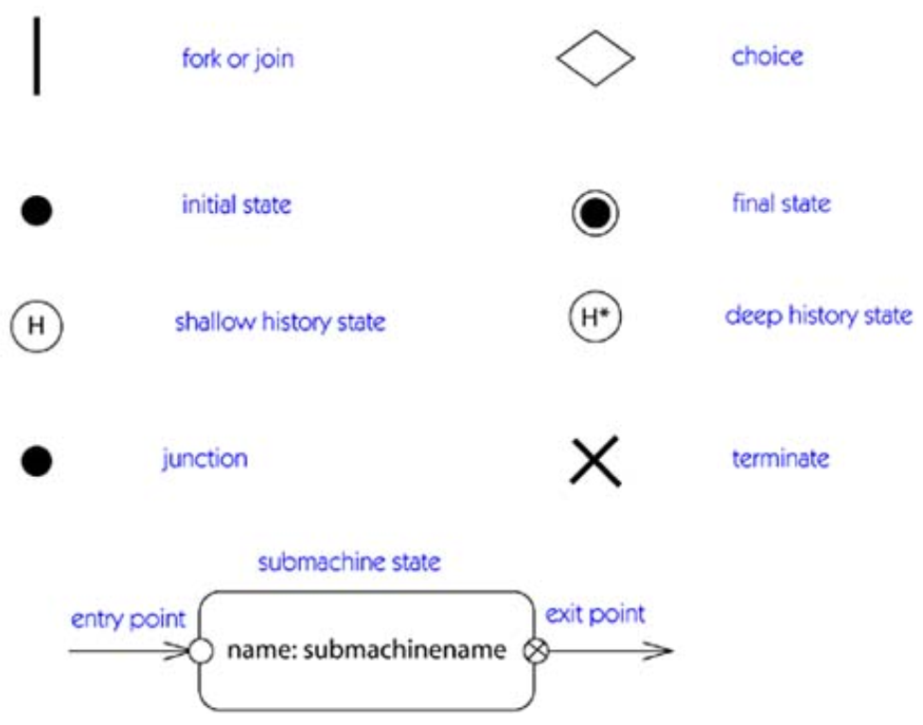

Slide 19
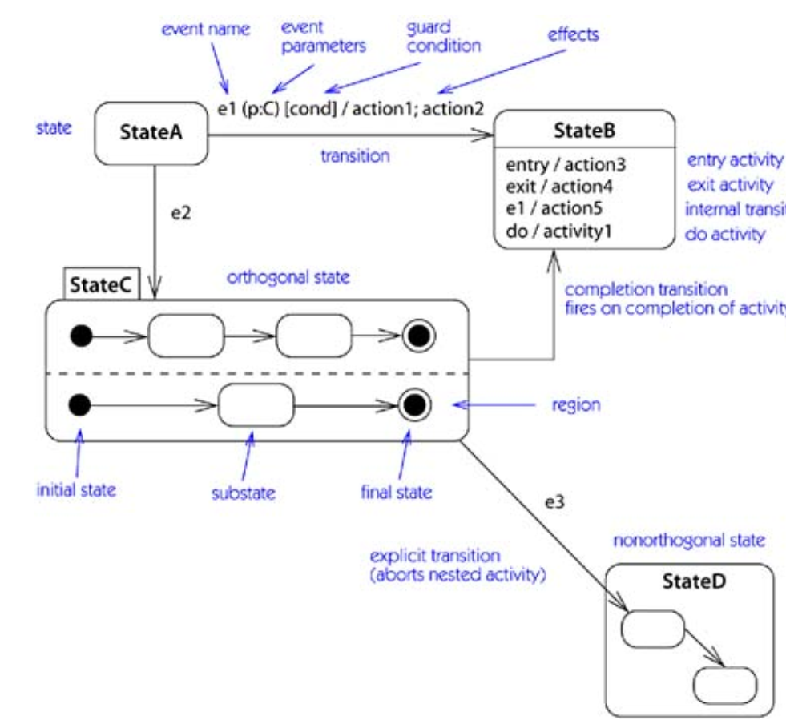
State machine notation

Slide 20
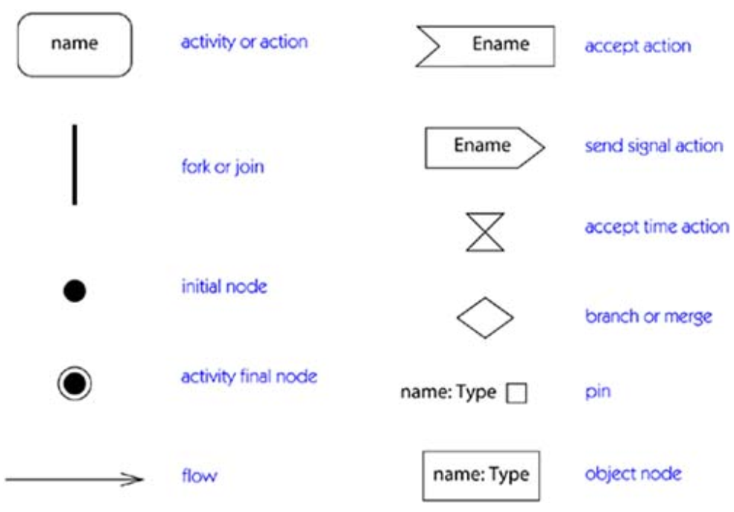
Icons on activity diagrams

Slide 21
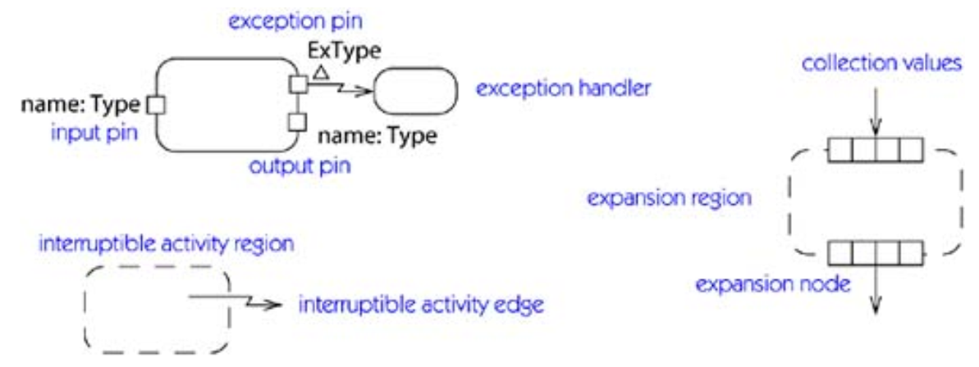
Activity groups and icons

Slide 22
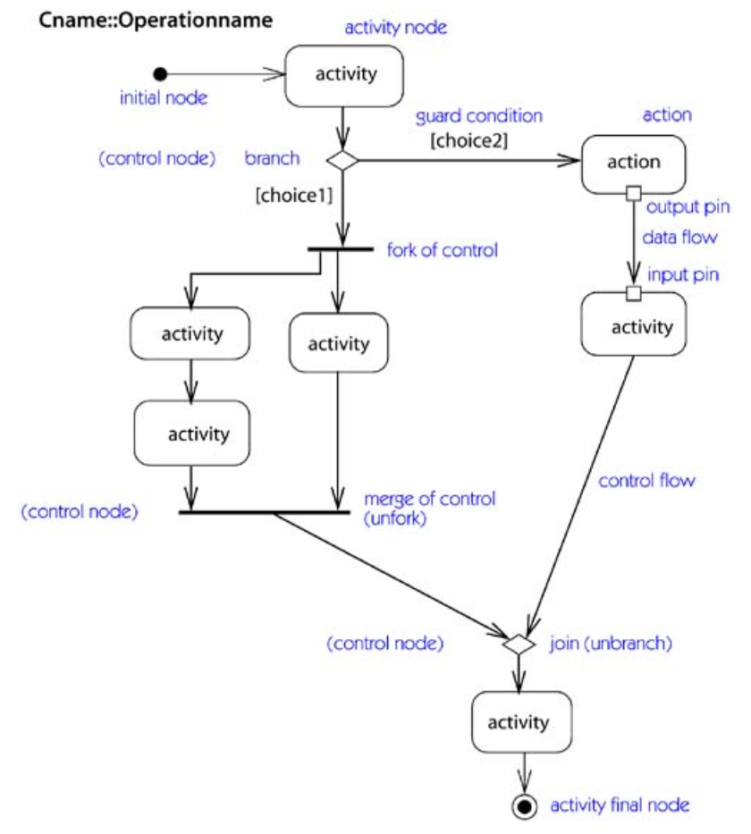
Activity diagram notation

Slide 23
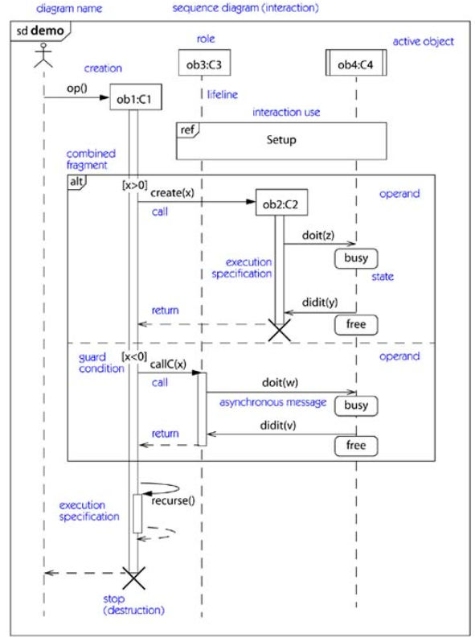
Sequence diagram notation

Slide 24
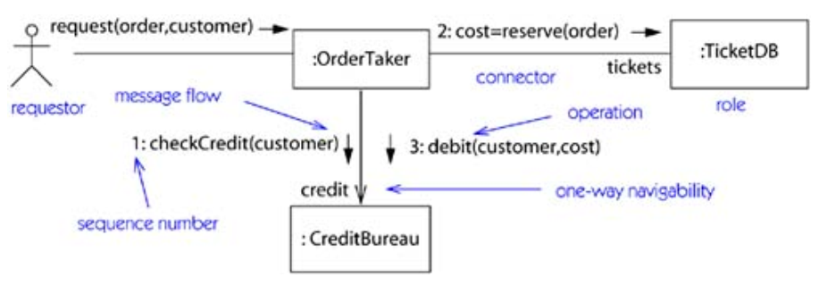
Communication diagram notation

Slide 25

Message notation

Slide 26
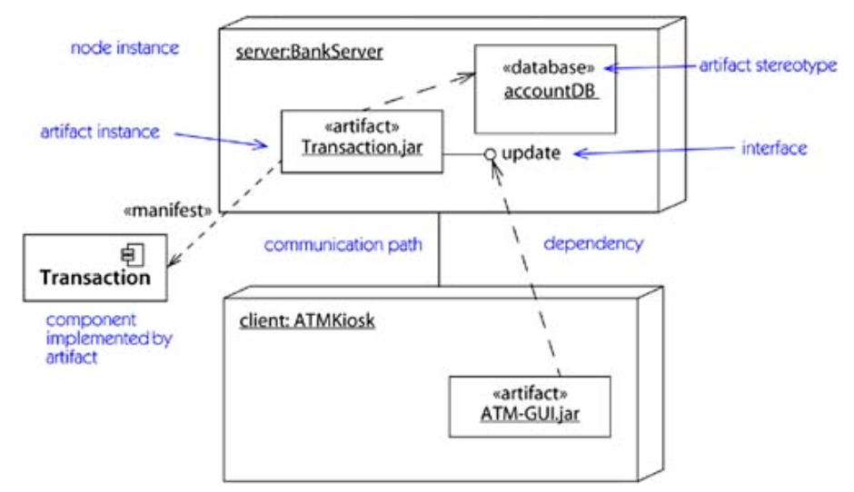
Node and artifact notation

Slide 27
The End!

